Slide 1
www.nr.no
ggplot2
- spatial plotting
Norsk statistikermøte, Halden, 11. juni 2013
Elisabeth Orskaug
Thordis Thorarinsdottir
Norsk Regnesentral
André Teigland
Forskningssjef
SAMBA

Slide 2
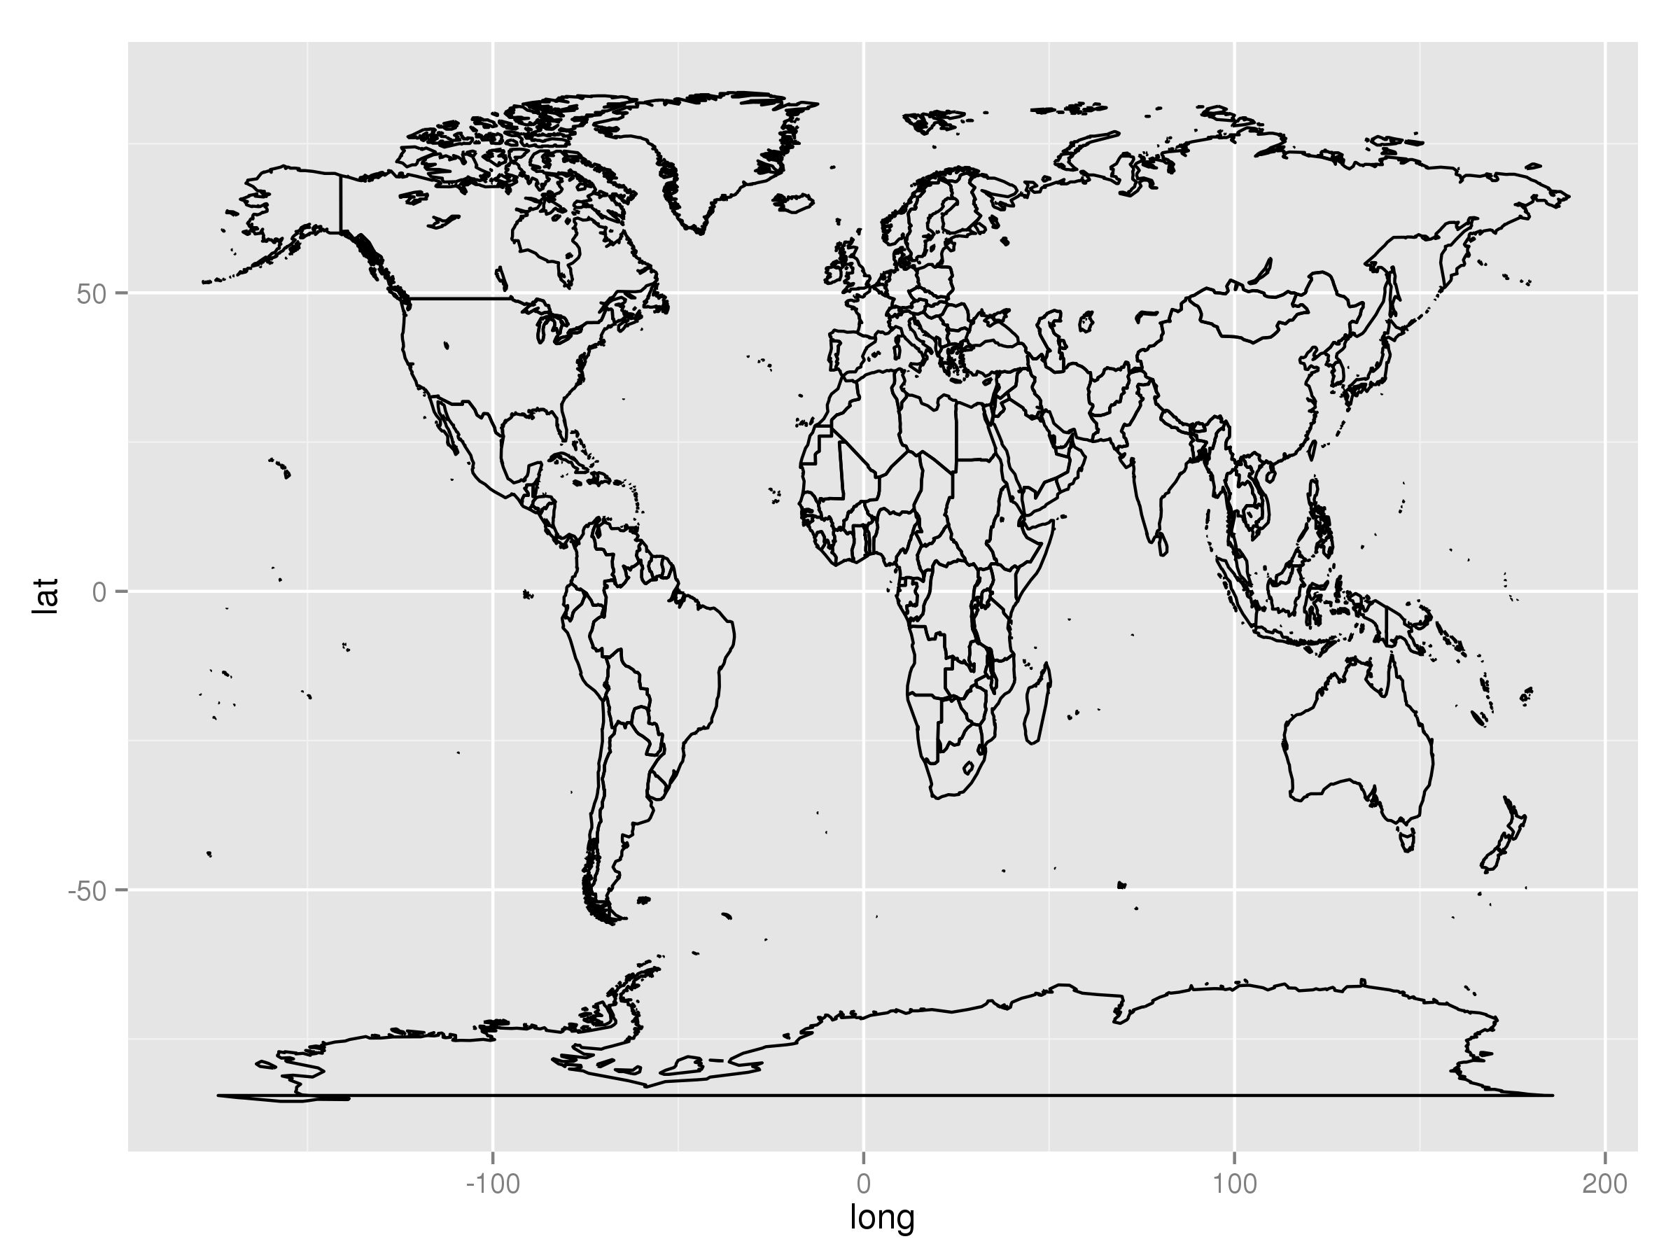
4. ggplot2-spatial
Spatial visualization with qplot()
Section 4.1
Using functions in R, one can plot basic geographic information, for instance a shape file containing polygons for areal data.
Areal data is data which corresponds to geographical extents with polygonal boundaries.
<numer>/20

Slide 3
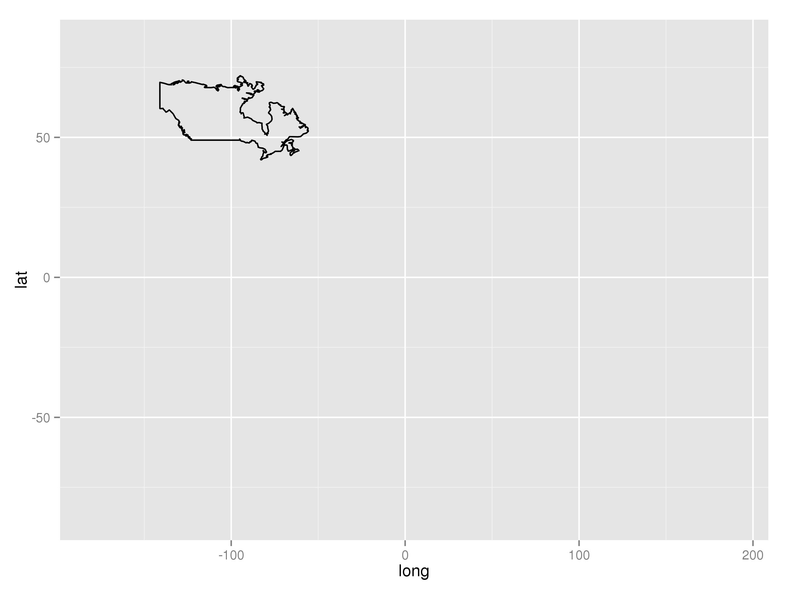
4. ggplot2-spatial
Spatial visualization with qplot()
Section 4.2
Taking out one area from world map
ind = which(world[,3]==1)
qplot(long,lat,data=world[ind,],geom="path", group=group) + xlim(range(world[,1])) + ylim(range(world[,2]))
Example: world data set
long lat group order region subregion
1 -133.3664 58.42416 1 1 Canada <NA>
2 -132.2681 57.16308 1 2 Canada <NA>
3 -132.0498 56.98610 1 3 Canada <NA>
4 -131.8797 56.74001 1 4 Canada <NA>
5 -130.2492 56.09945 1 5 Canada <NA>
6 -130.0131 55.91169 1 6 Canada <NA>
<numer>/20

Slide 4
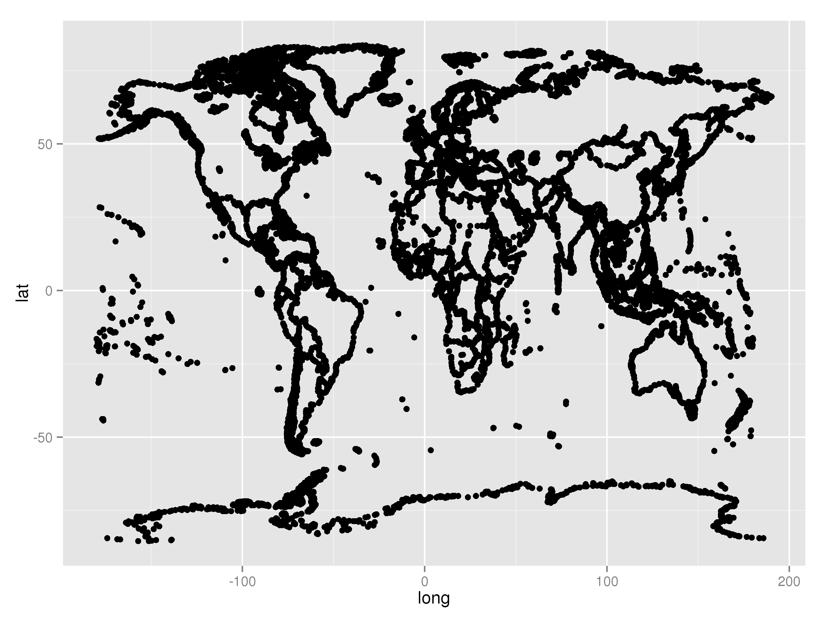
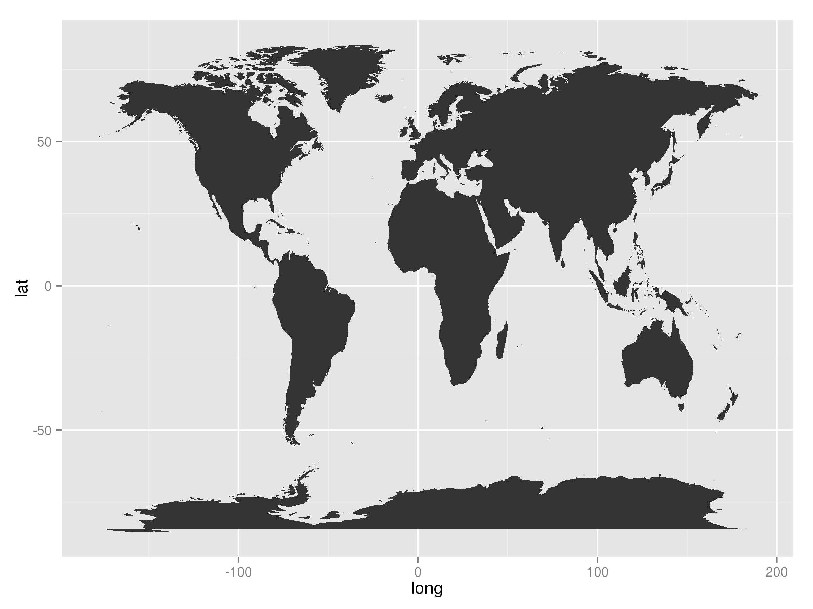
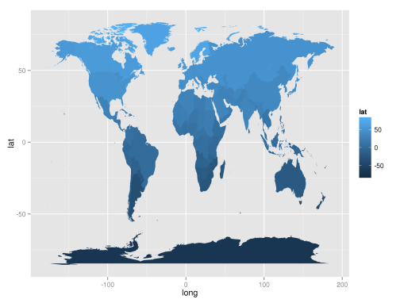
4. ggplot2-spatial
Spatial visualization with qplot()
Section 4.3
Plot map with function qplot()
qplot(long,lat,data=world,geom="point",group=group)
geom="point"
geom="path"
geom="polygon"
geom="polygon", fill=lat
<numer>/20

Slide 5
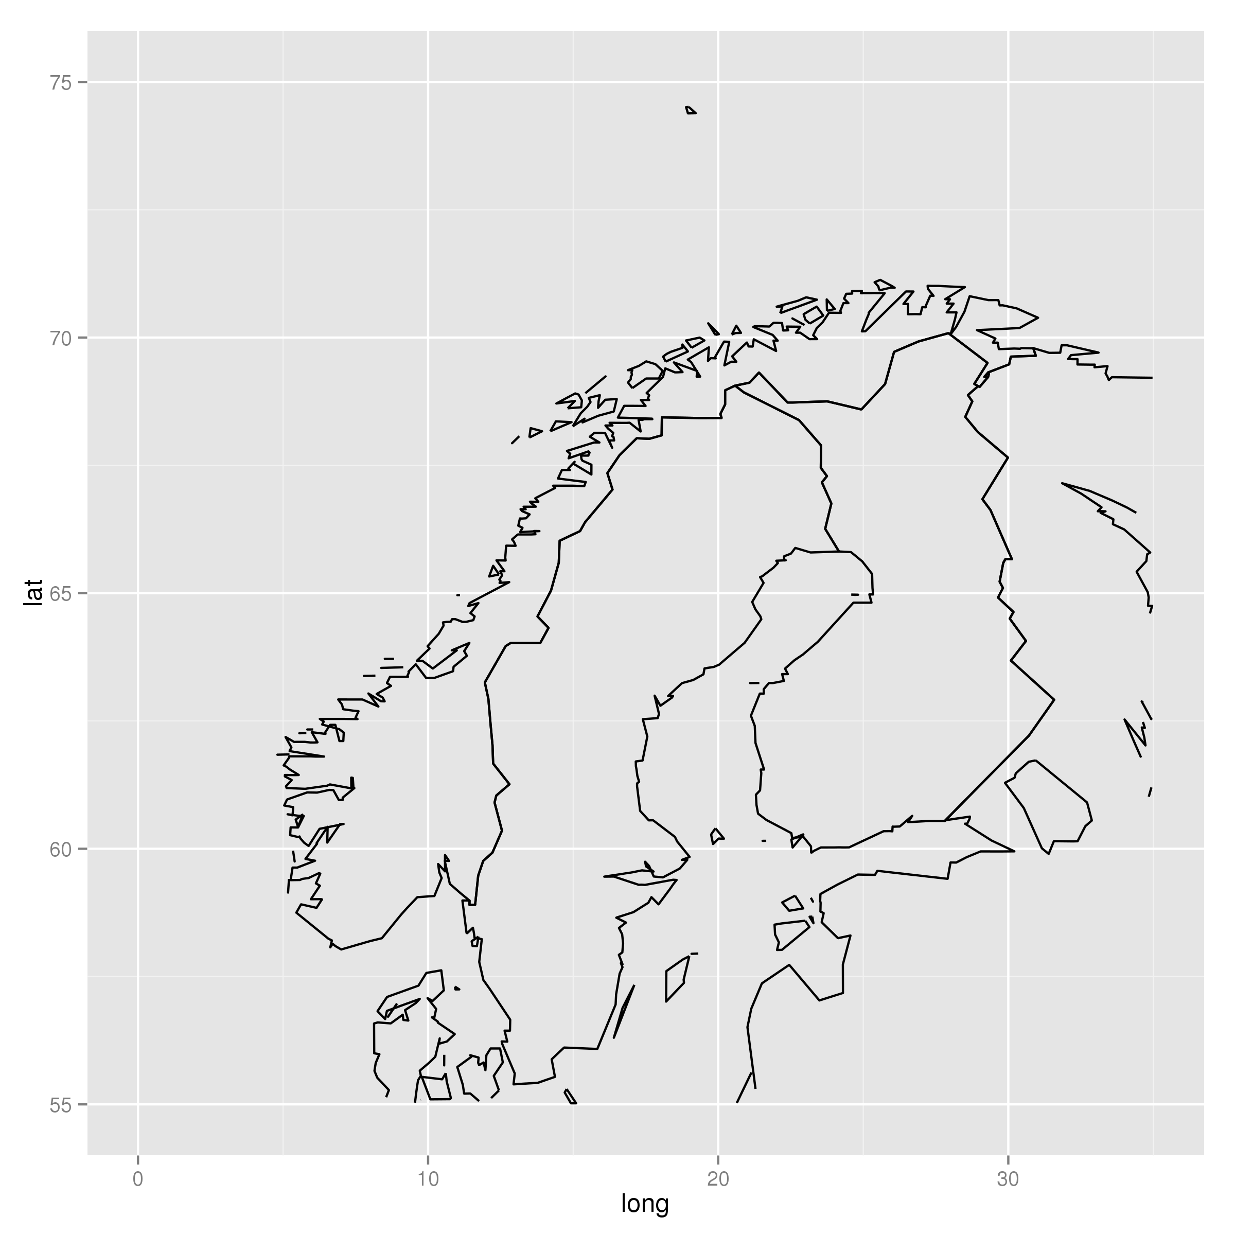
4. ggplot2-spatial
Spatial visualization with qplot()
Section 4.4
Zoom in on locations in the map:
qplot(long, lat, data=world, geom="path", group = group) + xlim(c(0,35)) + ylim(c(50,75))
<numer>/20

Slide 6
4. ggplot2-spatial
Assignment
Section 4.5
Make a map that zooms in on Afrika, and fill the area with red color. The longer north, the darker color. (You can try to change the fill color also for instance to red. Hint: ?scale_fill_gradient )
<numer>/20

Slide 7
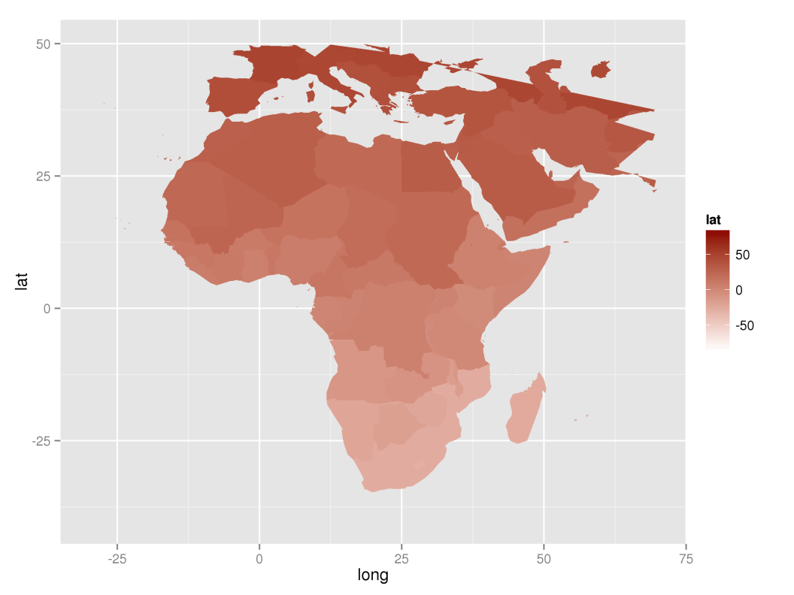
4. ggplot2-spatial
Suggestion
qplot(long, lat, data=world, geom="polygon", group = group,fill=lat) + xlim(c(-30,70)) + ylim(c(-40,50)) + scale_fill_gradient(low = "white", high = "dark red")
<numer>/20

Slide 8
4. ggplot2-spatial
Spatial visualization with ggplot()
Section 4.6
Plotting map:
map = geom_path(aes(x=long, y=lat, group = group), data=world)
ggplot() + map
<numer>/20

Slide 9
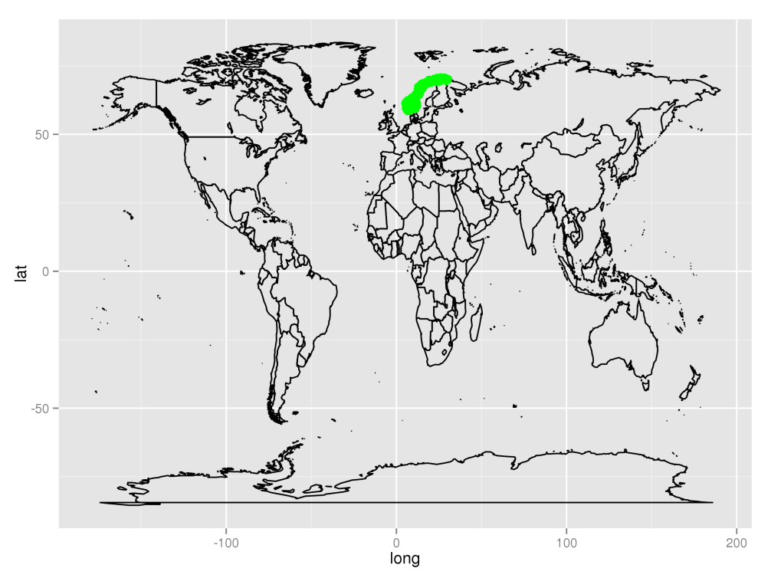
4. ggplot2-spatial
Spatial visualization with ggplot()
Section 4.7
Plotting points on a map:
ggplot() + map + geom_point(aes(x=lon,y=lat),colour="green", data=norwayGrid)
<numer>/20

Slide 10
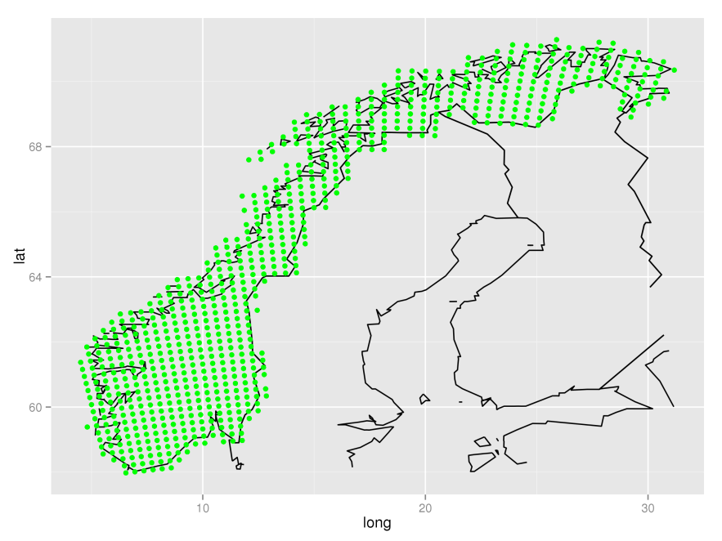
4. ggplot2-spatial
Spatial visualization with ggplot()
Zoom in on locations in the map:
ggplot() + map + geom_point(aes(x=lon,y=lat),colour="green", data=norwayGrid) + xlim(range(norwayGrid$lon)) + ylim(range(norwayGrid$lat))
map = list(geom_path(aes(x=long, y=lat, group = group), colour="grey50", data=world), scale_x_continuous(limits=range(norwayGrid$lon)), scale_y_continuous(limits = range(norwayGrid$lat)) )
Section 4.8
<numer>/20

Slide 11
4. ggplot2-spatial
Assignment
Section 4.9
Zoom in on Australia with ggplot() using data from data set world. Hint: use region=="Australia"
<numer>/20

Slide 12
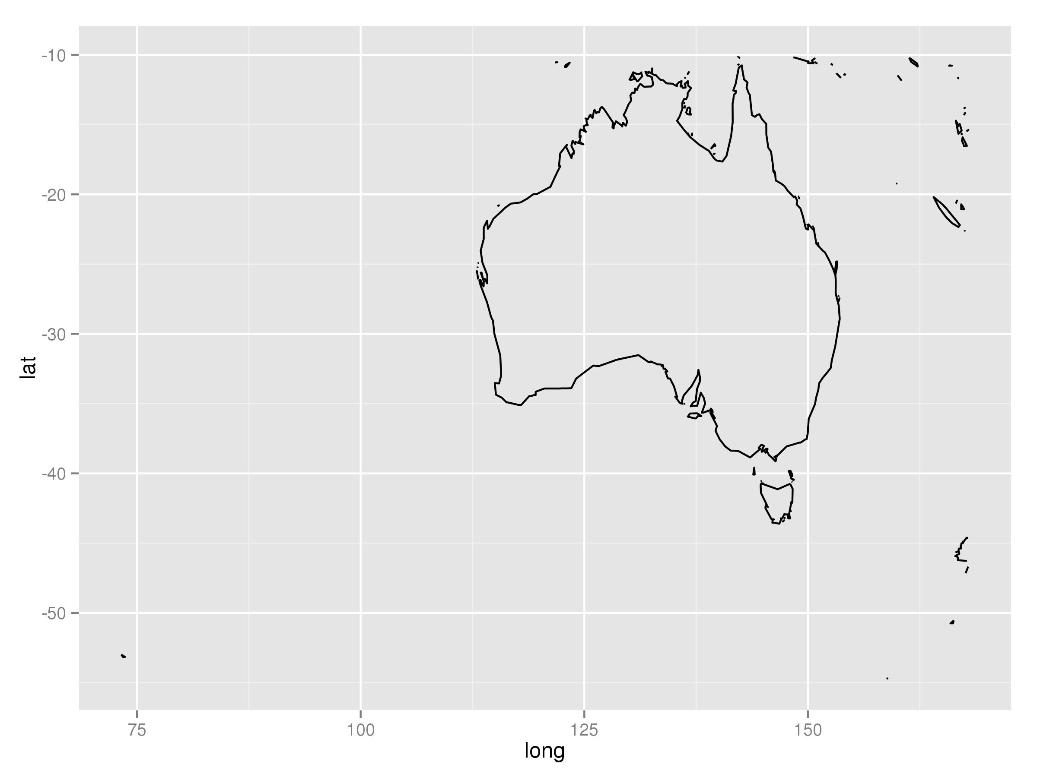
4. ggplot2-spatial
Suggestion
ind = which(world$region=="Australia")
ggplot() + map + xlim(range(world[ind,1])) + ylim(range(world[ind,2]))
<numer>/20

Slide 13
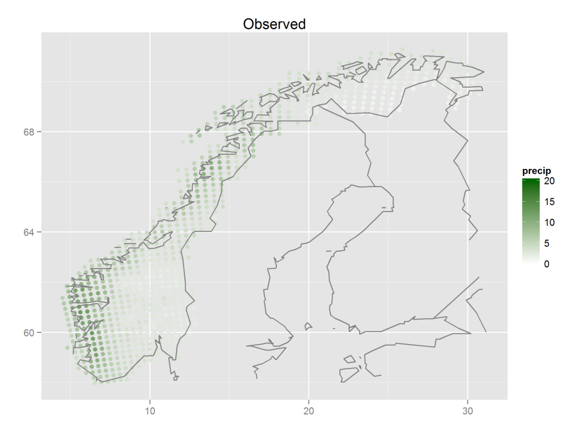
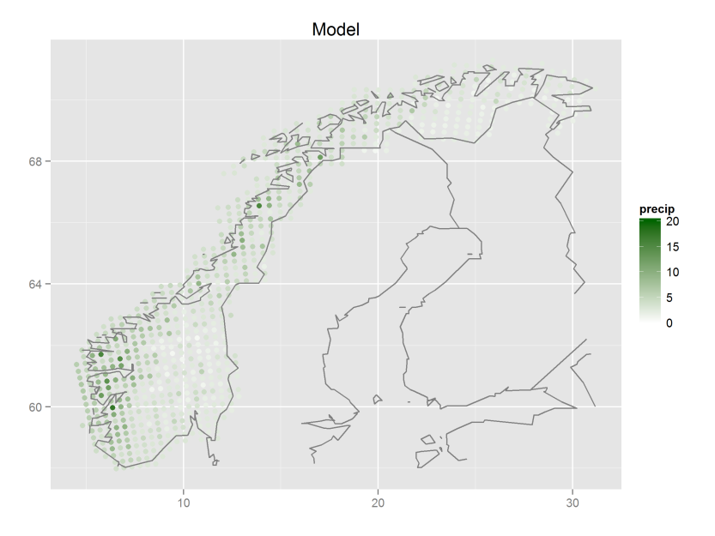
4. ggplot2-spatial
Spatial map with time series
Section 4.10
Plotting precipitation over the norwegian mainland, both model and observations:
1) qplot(lon, lat, data=all.stats, colour=obs.mean, geom="point", xlab="", ylab="", main="Observed") + scale_colour_gradient(name="precip", limits=c(0,20), low="white", high="green") + map
2) qplot(lon, lat, data=all.stats, colour=mod.mean, geom="point", xlab="", ylab="", main="Model") + scale_colour_gradient(name="precip", limits=c(0,20), low="white", high="green") + map
<numer>/20

Slide 14
4. ggplot2-spatial
Assignment
Section 4.11
Make a spatial map of the difference in precipitation in 3.-quartile (Q3) for observed data and model data. Choose blue color scale.
<numer>/20

Slide 15
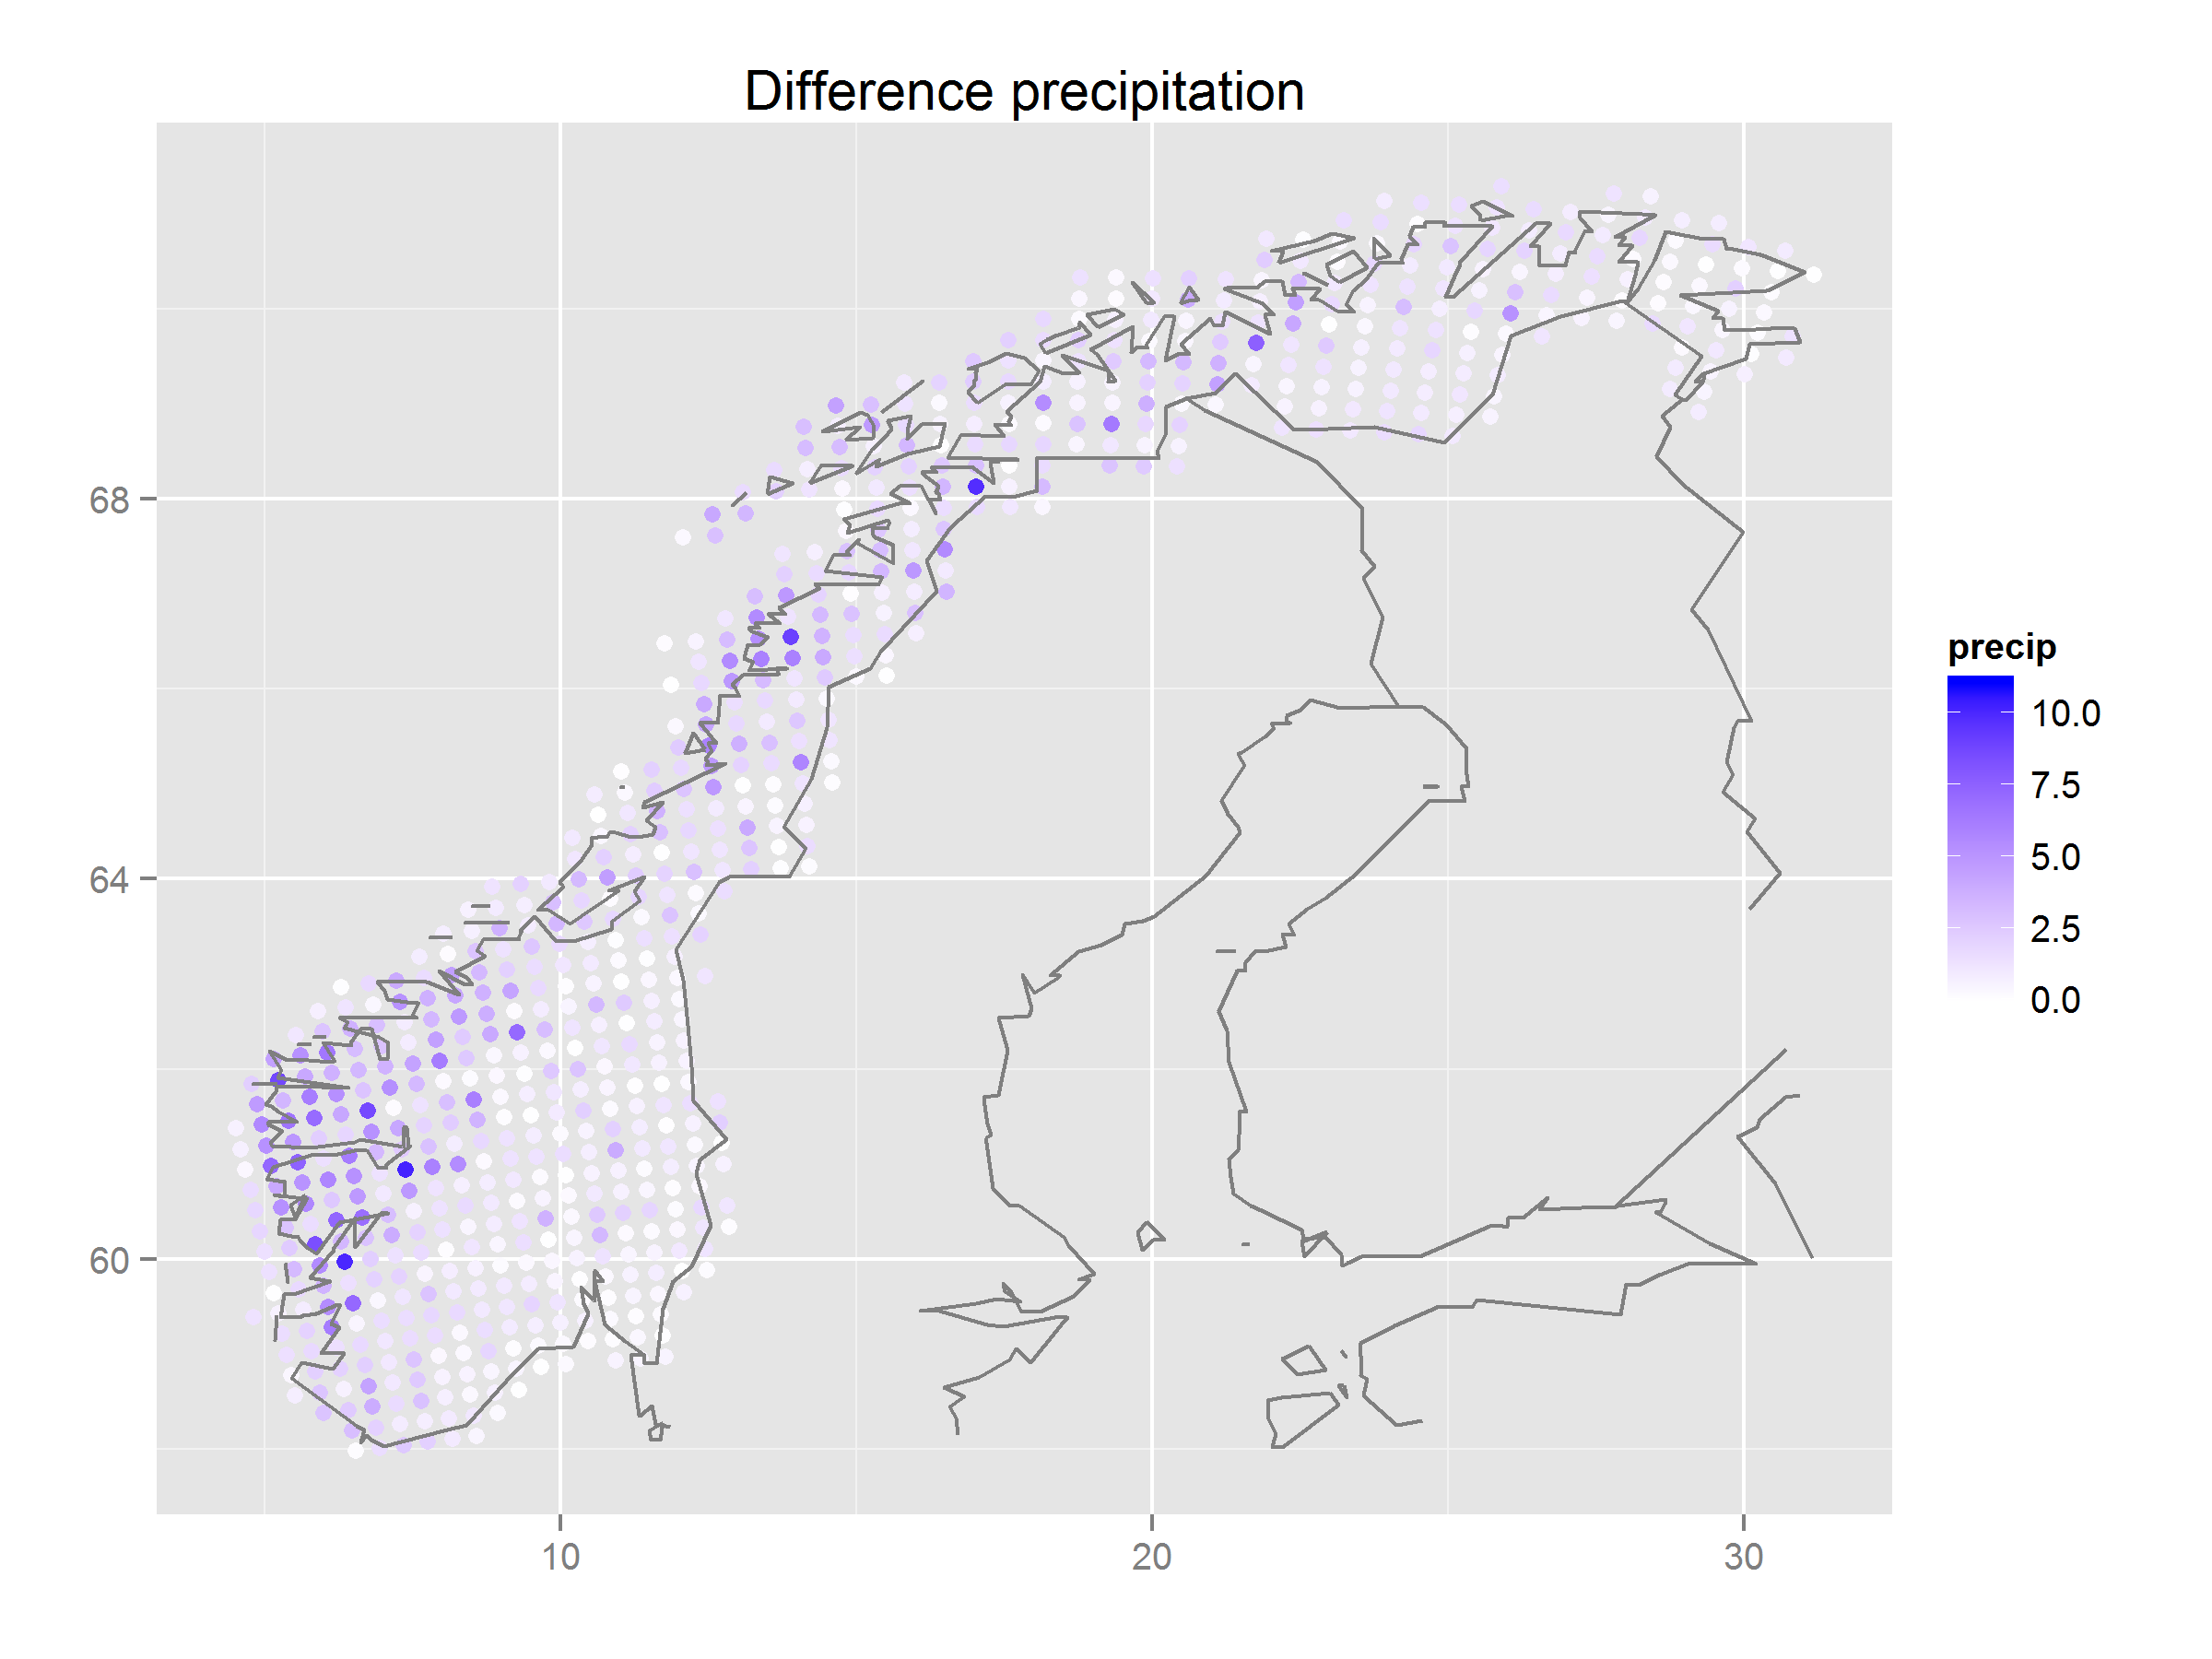
4. ggplot2-spatial
Suggestion
qplot(lon, lat, data=all.stats, colour=abs(obs.Q3-mod.Q3), geom="point", xlab="", ylab="", main="Difference precipitation") + scale_colour_gradient(name="precip", limits=c(0,11), low="white", high="blue") + map
<numer>/20

Slide 16
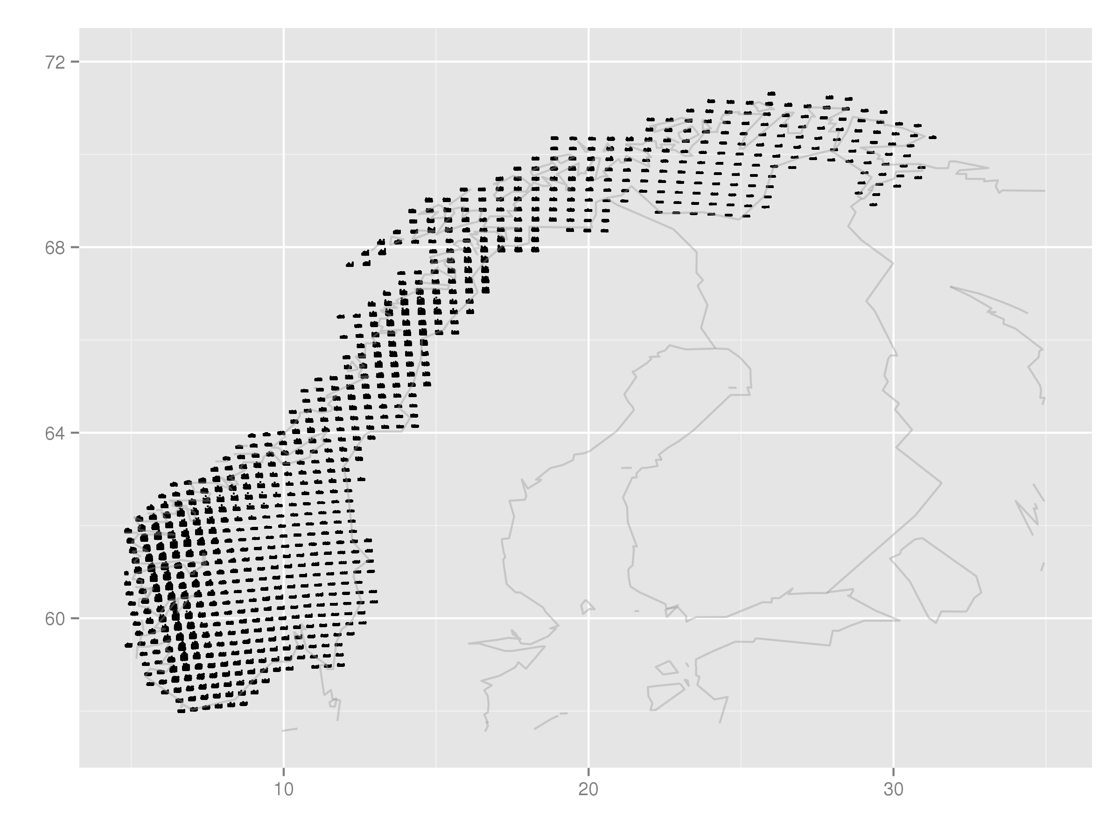
4. ggplot2-spatial
Spatial map with time series
Section 4.12
Observations with time series in each grid point:
qplot(lon+time_r/5, lat+OBS_r/5, data=data.grid.mth.agg, xlab="", ylab="", group=interaction(lon, lat), size=I(0.5), xlim=c(4.8, 35), ylim=c(57.5, 72)) + map
<numer>/20

Slide 17
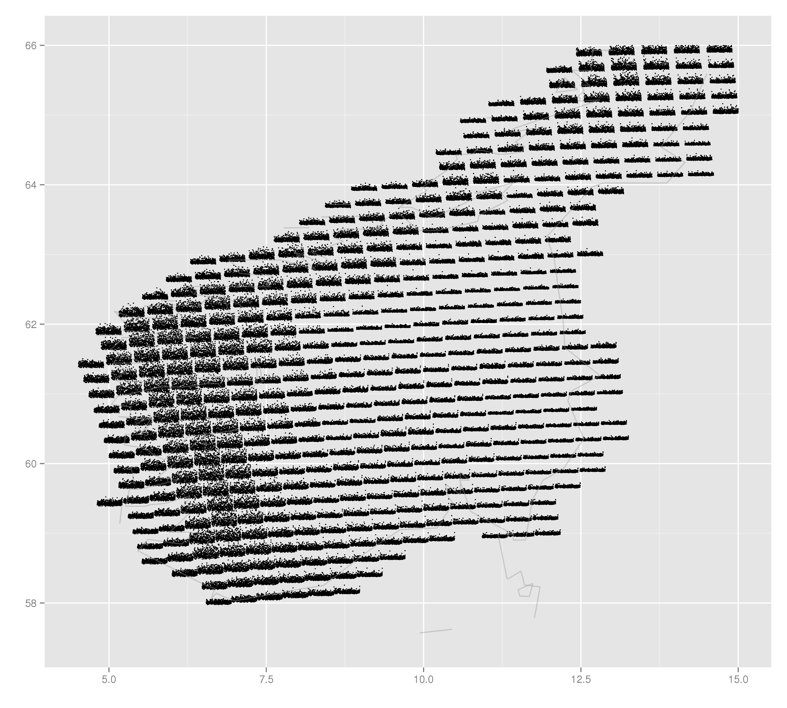
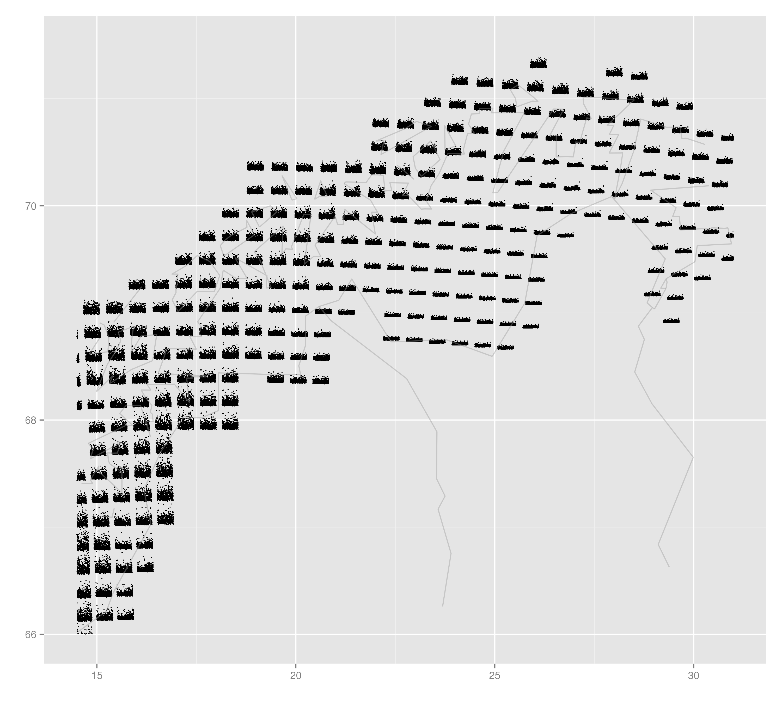
4. ggplot2-spatial
Spatial map with time series
Split Norway in two:
Adjust xlim and ylim.
Section 4.13
<numer>/20

Slide 18
4. ggplot2-spatial
Assignment
Section 4.14
Make a spatial map with seasonal time series of the observations, and split the map in two. Hint: use month_r
<numer>/20

Slide 19
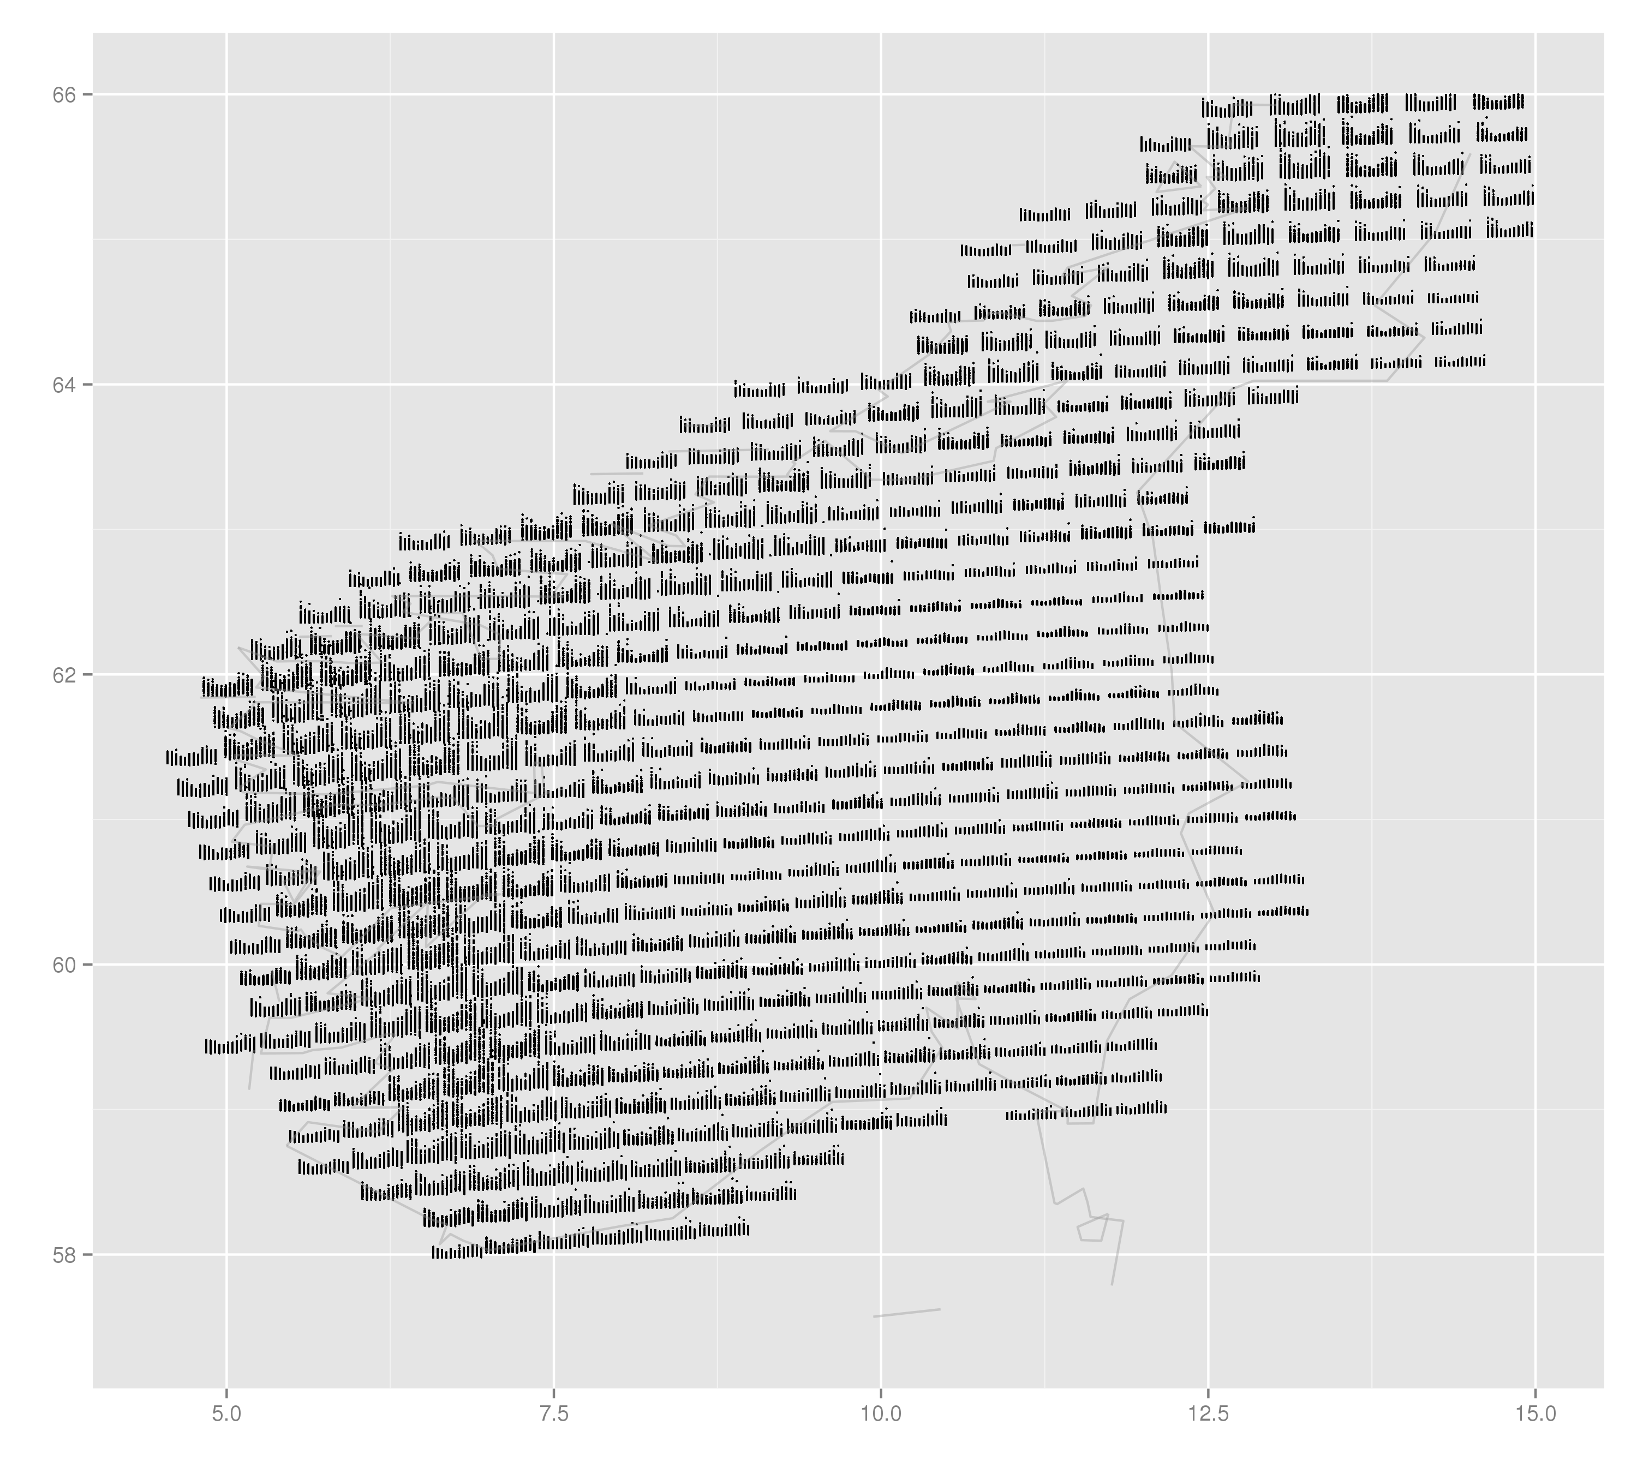
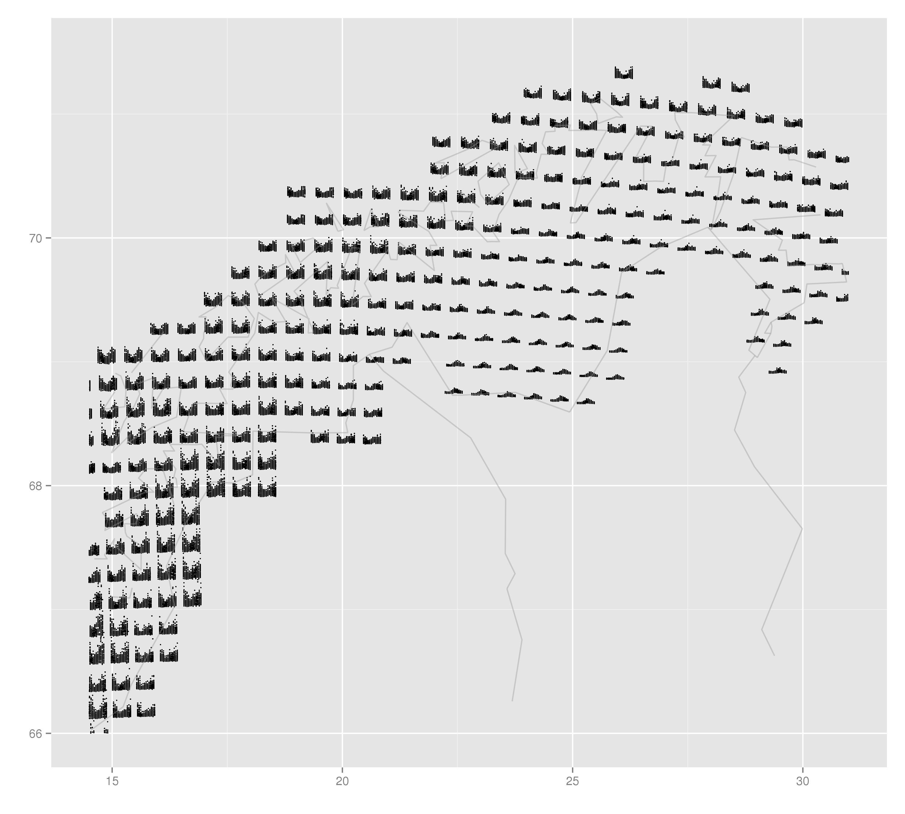
4. ggplot2-spatial
Suggestion
1) qplot(lon+month_r/2.5, lat+OBS_r/2.5, data=data.grid.mth.agg, xlab="", ylab="", group=interaction(lon, lat), size=I(0.5), xlim=c(4.5, 15), ylim=c(57.5, 66)) + map
2) qplot(lon+month_r/2.5, lat+OBS_r/2.5, data=data.grid.mth.agg, xlab="", ylab="", group=interaction(lon, lat), size=I(0.5), xlim=c(14.5, 31), ylim=c(66, 71.5)) + map
<numer>/20

Slide 20

www.nr.no
Coffee break
André Teigland
Forskningssjef
SAMBA

